Slide 1
F2F Meeting 25-06-24

Slide 2
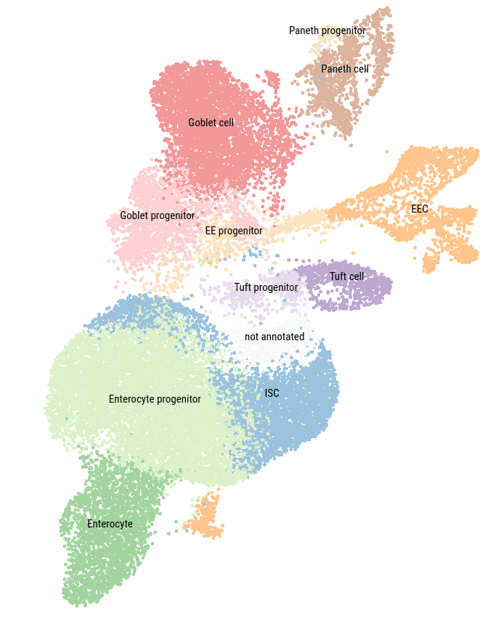
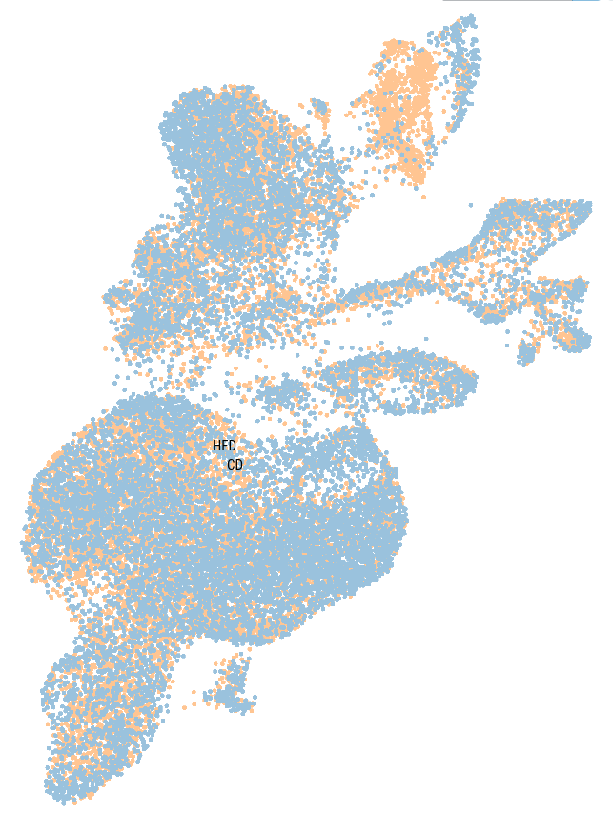
UMAP
- 27,687 Cells
- 9 Clusters
- CD vs HFHSD

Slide 3
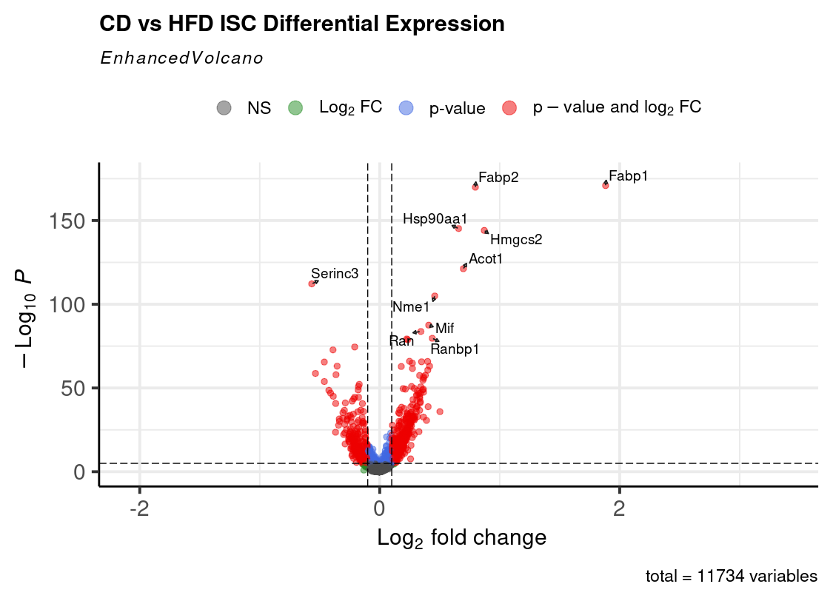
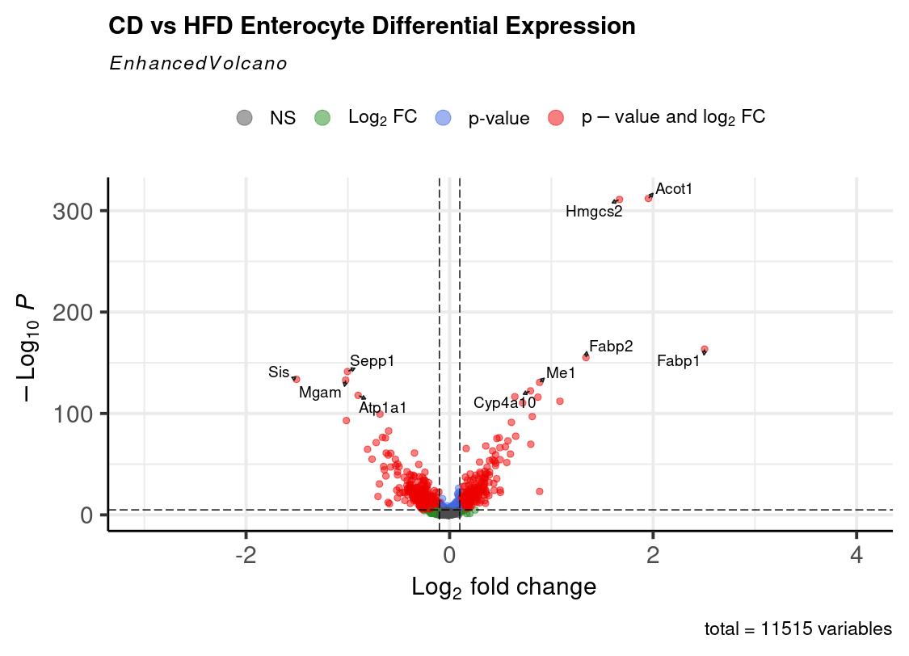
DEG analysis

Slide 4
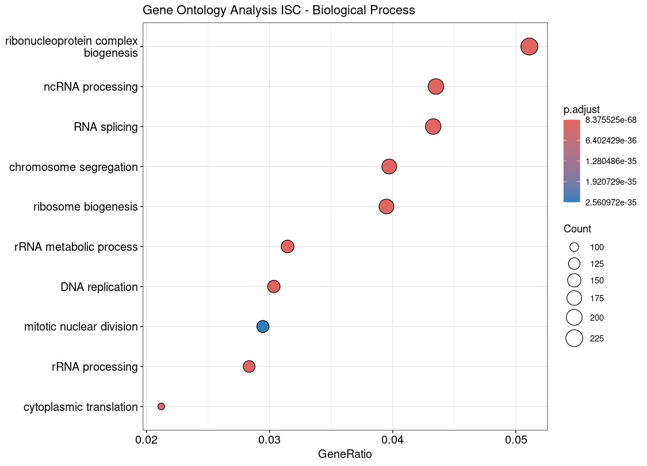
GO Analysis ISC

Slide 5
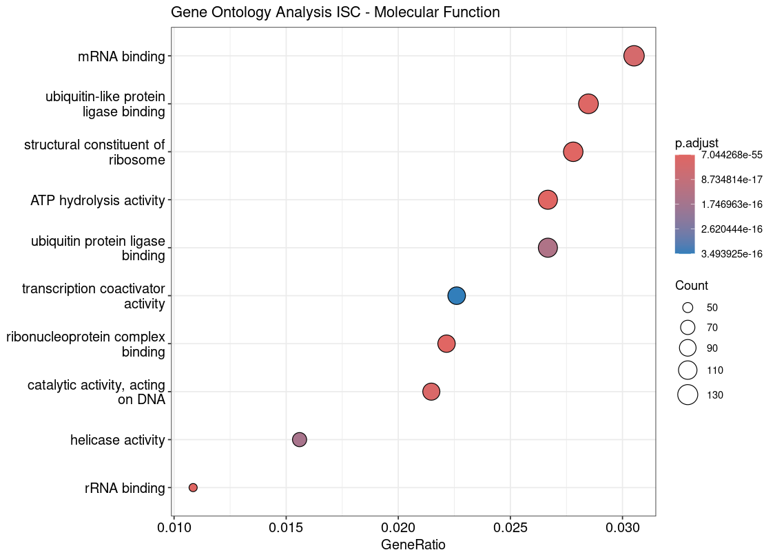
GO Analysis ISC

Slide 6
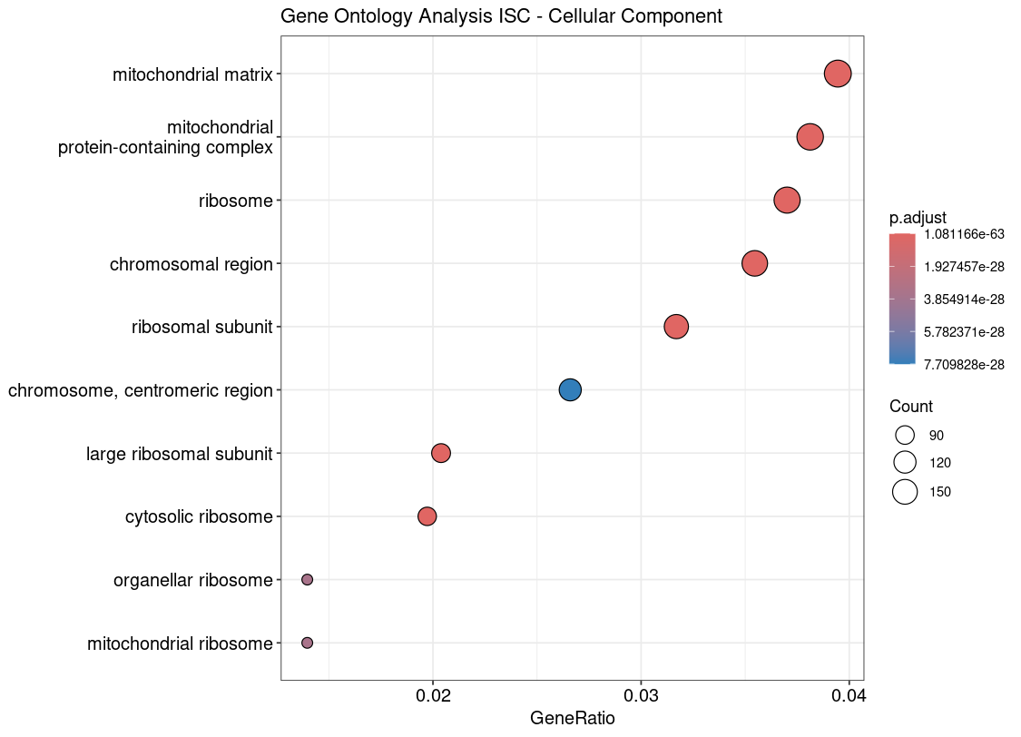
GO Analysis ISC

Slide 7
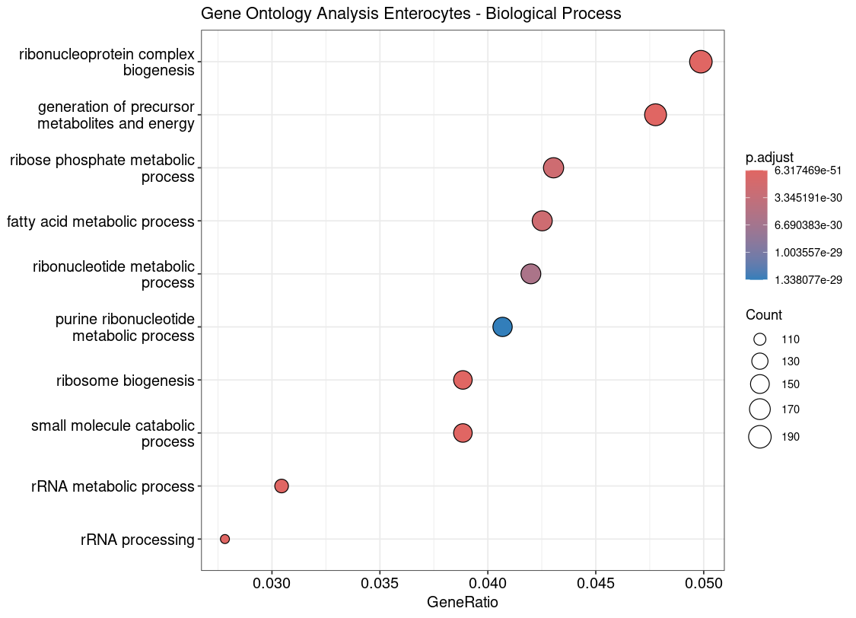
GO Analysis Enterocytes

Slide 8
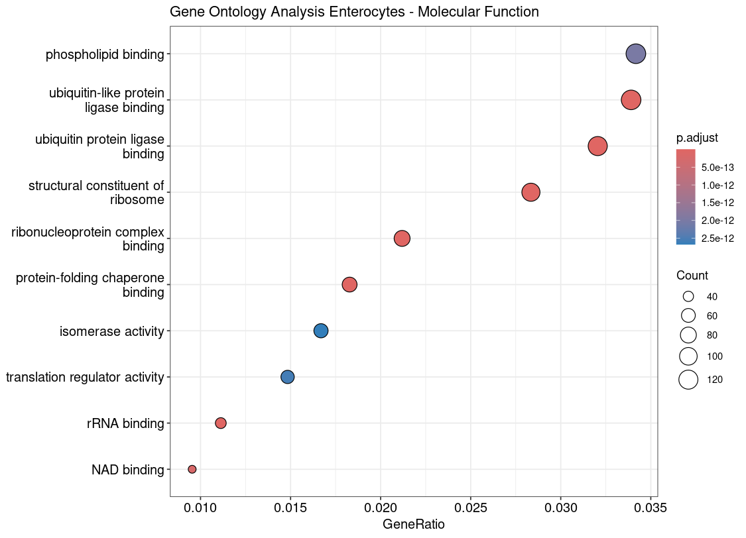
GO Analysis Enterocytes

Slide 9
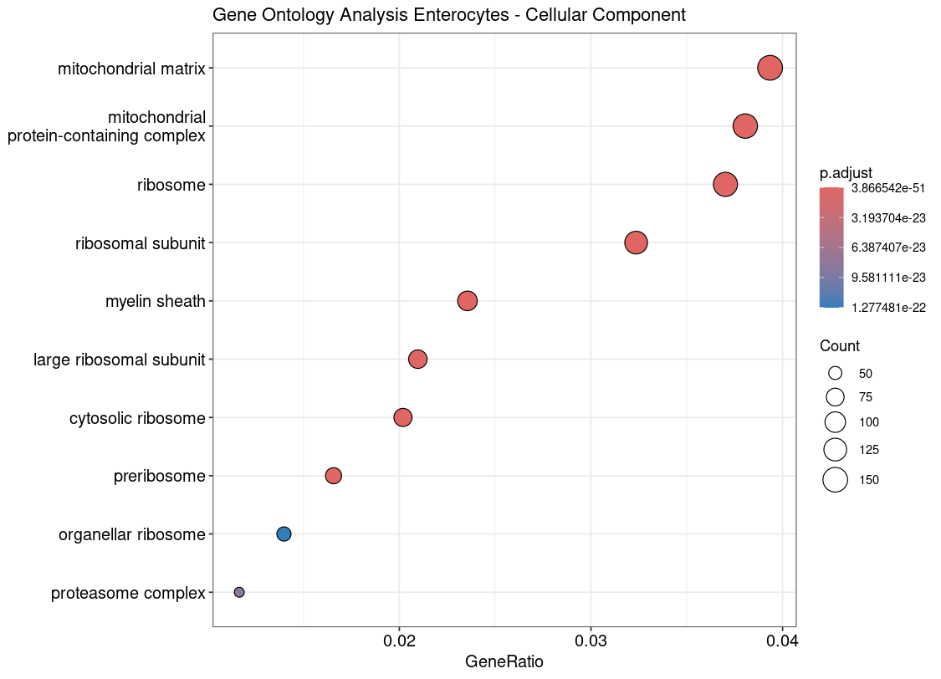
GO Analysis Enterocytes

Slide 10
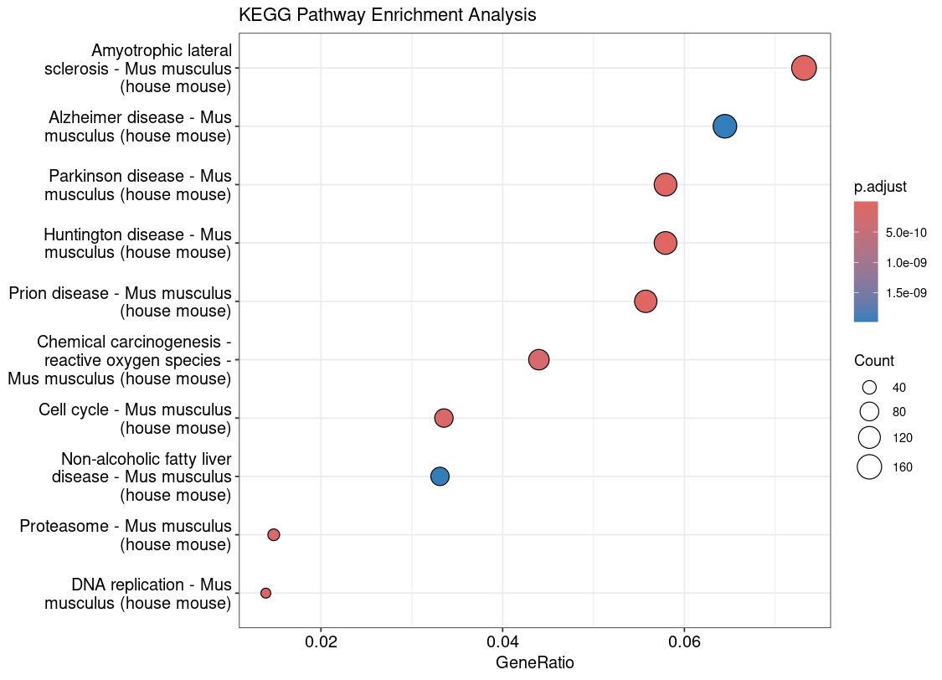
KEGG Pathway Analysis (ISC)

Slide 11
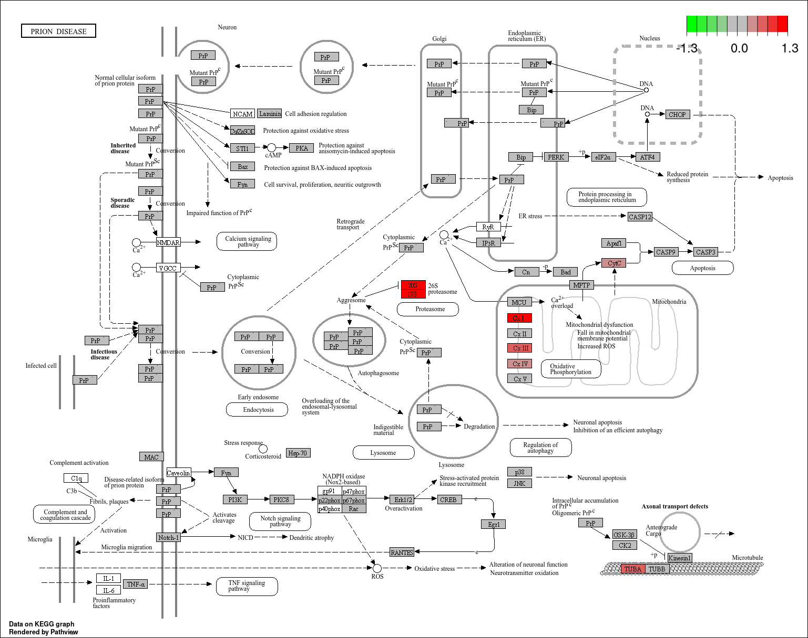
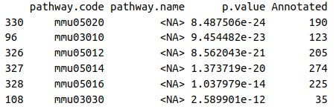
KEGG Pathway Analysis (ISC)
Pathway mmu05020: Prion Disease

Slide 12
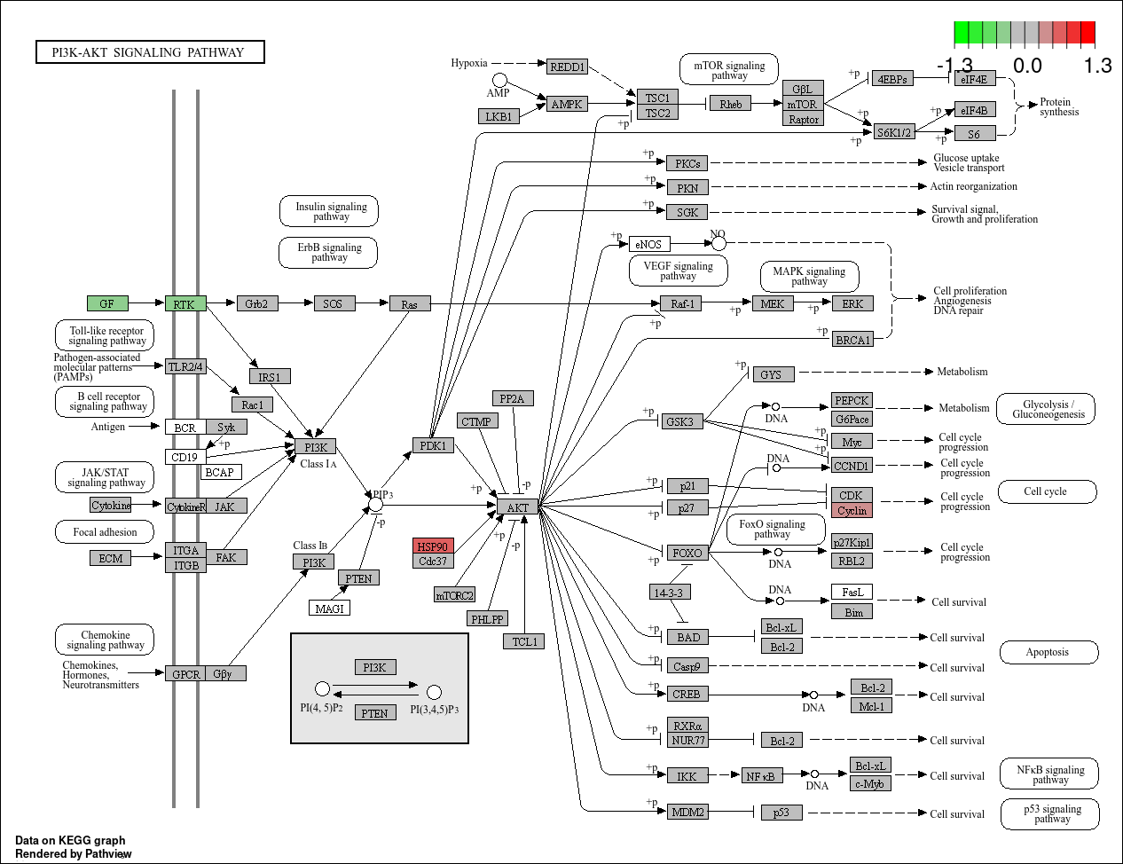
ISC – PI3K / AKT

Slide 13
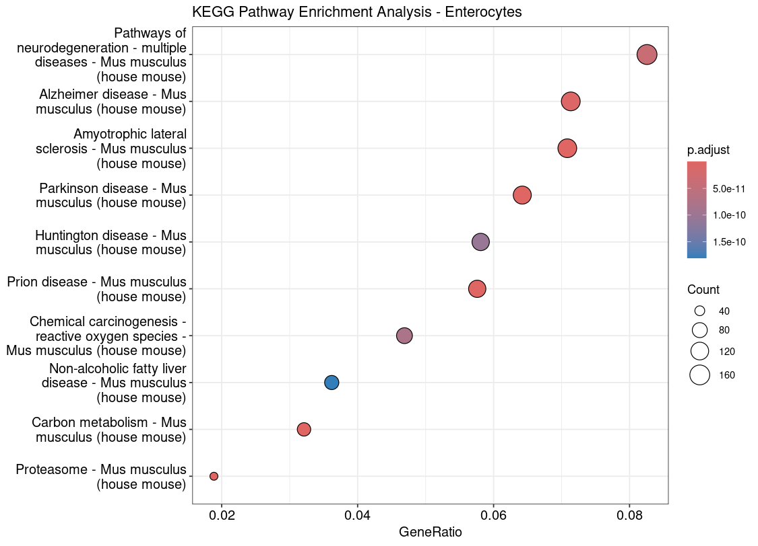
KEGG Pathway Analysis (Entcyt.)

Slide 14
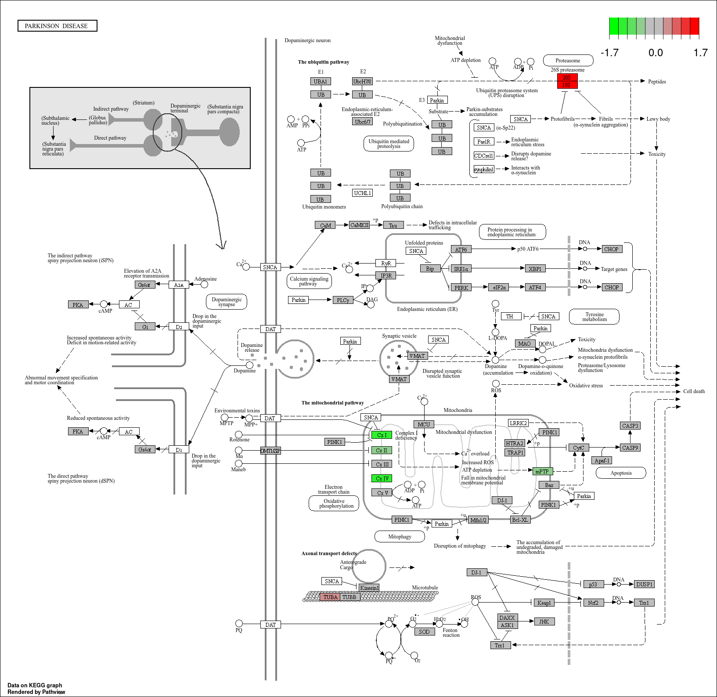
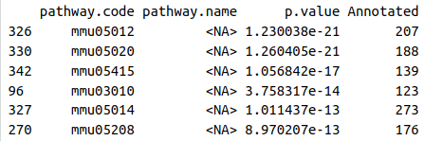
KEGG Pathway Analysis (Entcyt.)
Pathway mmu05020: Prion Disease

Slide 15
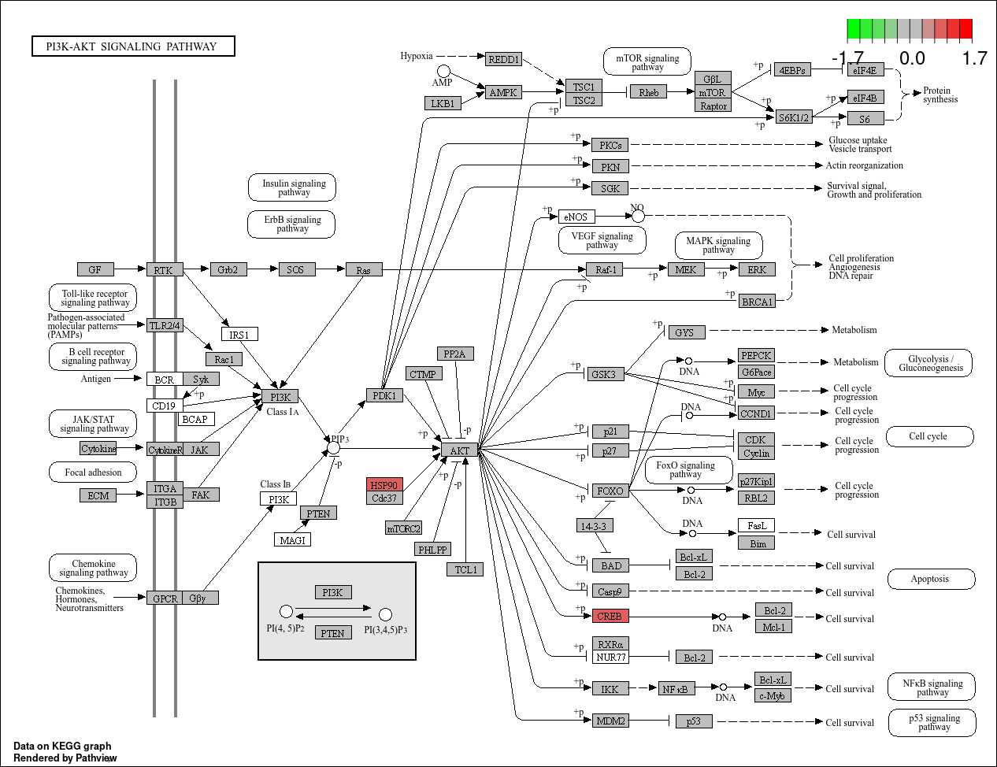
Enterocytes – PI3K / AKT

Slide 16
Fixed slides for presentation next

Slide 17
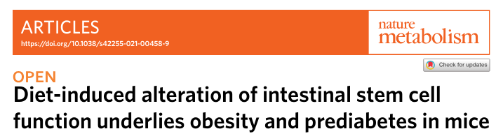
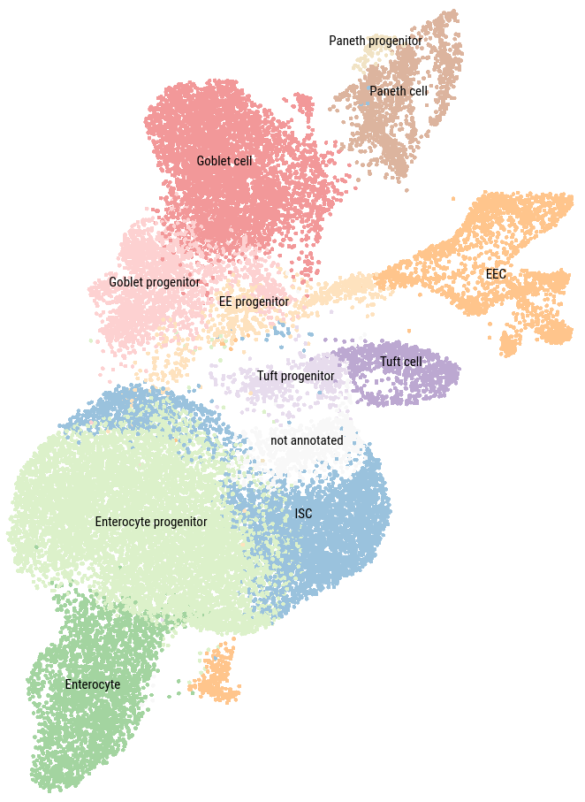

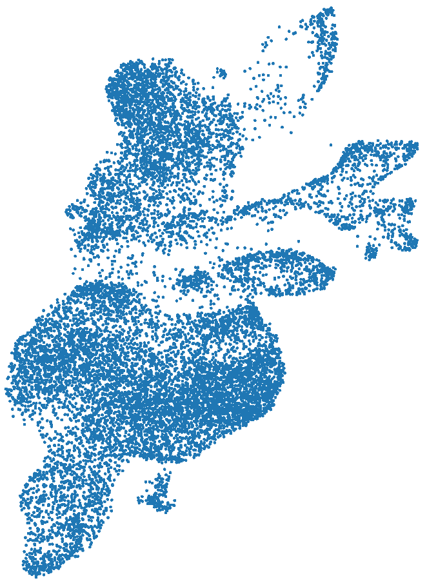
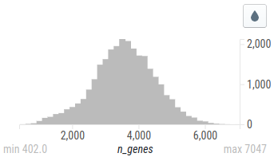
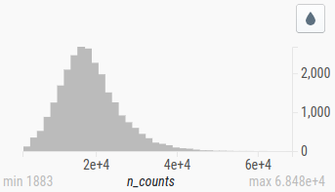
scRNA-seq dataset
Distribution of number of unique genes expressed per cell
Distribution of gene counts per cell
9 clusters
27,687 cells
HFHS Diet Cells
14,321 cells
Control Diet Cells
13,366 cells

Slide 18
DGE analysis
Fabp: Fatty acid binding protein genes
Hsp90: Heat shock protein, apoptosis inhibitor
Hmgcs2: Mitochondrial enzyme catalysing ketogenesis
Acot1: Acyl-CoA Thioesterase 1 (Fatty acid metabolism)
Me1: Malic Enzyme 1 (Fatty acid biosynthesis)
Notable Genes:
Fabp: Fatty acid binding protein genes
Hsp90: Heat shock protein, apoptosis inhibitor
Hmgcs2: Mitochondrial enzyme catalysing ketogenesis
Acot1: Acyl-CoA Thioesterase 1 (Fatty acid metabolism)

